Slide 1
Relational Algebra Operations & Extended Relational Algebra Operations
Chapter - 4

Slide 2
Outline
Relational Algebra
  Unary Relational Operations
  Relational Algebra Operations From Set Theory
  Binary Relational Operations
  Additional Relational Operations
  Examples of Queries in Relational Algebra

Slide 3
Describing a Relational Database Mathematically: Relational Algebra
Tables in a relational database as sets of tuples
Query operators using set theory
The query language is called relational algebra
Normally, not used directly - foundation for SQL and query processing
  SQL adds syntactic sugar

Slide 4
What is an “Algebra”?
In general, algebra is the study of mathematical symbols and the rules for manipulating these symbols
Mathematical system consisting of
  Operands - variables or values from which new values can be constructed
  Operators - symbols denoting procedures that construct new values from given values
Expressions can be constructed by applying operators to atomic operands and/or other expressions
  Operations can be composed - algebra is closed (Since each operation returns a relation)
  Parentheses are needed to group operators

Slide 5
Relational Algebra -Overview
Relational algebra is the basic set of operations for the relational model
These operations enable a user to specify basic retrieval requests (or queries)
The result of an operation is a new relation, which may have been formed from one or more input relations
  This property makes the algebra “closed” (all objects in relational algebra are relations)
The algebra operations thus produce new relations
  These can be further manipulated using operations of the same algebra
A sequence of relational algebra operations forms a relational algebra expression
  The result of a relational algebra expression is also a relation that represents the result of a database query (or retrieval request)

Slide 6
Relational Algebra Overview
Relational Algebra consists of several groups of operations
  Unary Relational Operations
    SELECT (symbol: σ (sigma))
    PROJECT (symbol: π (pi))
    RENAME (symbol: ρ (rho))
  Relational Algebra Operations From Set Theory
    UNION ( ∪ ), INTERSECTION ( ∩ ), DIFFERENCE (or MINUS, – )
    CARTESIAN PRODUCT ( x )
  Binary Relational Operations
    JOIN (several variations of JOIN exist)
    DIVISION
  Additional Relational Operations
    OUTER JOINS, OUTER UNION
    AGGREGATE FUNCTIONS (These compute summary of information: for example, SUM, COUNT, AVG, MIN, MAX)

Slide 7

Relational Schema – COMPANY Database

Slide 8
Unary Relational Operations: SELECT
The SELECT operation (denoted by σ (sigma)) is used to select a subset of the tuples from a relation based on a selection condition
  The selection condition acts as a filter
  Keeps only those tuples that satisfy the qualifying condition
  Tuples satisfying the condition are selected whereas the other tuples are discarded (filtered out)
  The SELECT operation can also be visualized as a horizontal partition of the relation into two sets of tuples
    those tuples that satisfy the condition and are selected, and those tuples that do not satisfy the condition and are discarded
Examples:
  Select the EMPLOYEE tuples whose department number is 4:
σ _{DNO = 4} (EMPLOYEE)

Slide 9
Unary Relational Operations: SELECT
  Select the employee tuples whose salary is greater than $30,000
σ _{SALARY > 30,000} (EMPLOYEE)
In general, the select operation is denoted by
σ _{<selection condition>}(R)
where
    the symbol σ (sigma) is used to denote the select operator
    the selection condition (made of a number of clauses) is a Boolean (conditional) expression specified on the attributes of relation R
      <attribute name> <comparison op> <constant value> (or)
      <attribute name> <comparison op> <attribute name>
    where
      <attribute name> is the name of an attribute of R,
      <comparison op> is normally one of the operators {=, <, ≤, >, ≥, ≠}, and
      <constant value> is a constant value from the attribute domain

Slide 10
Unary Relational Operations: SELECT
    Clauses can be connected by the standard Boolean operators and, or, and not to form a general selection condition
For example : To select the tuples for all employees who either work in department 4 and make over $25,000 per year, or work in department 5 and make over $30,000, we can specify the following SELECT operation:
  tuples that make the condition true are selected
      appear in the result of the operation
  tuples that make the condition false are filtered out
      discarded from the result of the operation

Slide 11
Unary Relational Operations: SELECT
The SELECT operator is unary; that is, it is applied to a single relation
The selection operation is applied to each tuple individually
The degree of the relation resulting from a SELECT operation-its number of attributes-is the same as the degree of R
The number of tuples in the resulting relation is always less than or equal to the number of tuples in R, for any condition c

Slide 12
Unary Relational Operations: SELECT
SELECT Operation Properties
  The SELECT operation σ _{<selection condition>}(R) produces a relation S that has the same schema (same attributes) as R
  SELECT σ is commutative
    σ _{<condition1>}(σ _{< condition2>} (R)) = σ _{<condition2>} (σ _{< condition1>} (R))
  Because of commutativity property, a cascade (sequence) of SELECT operations may be applied in any order
    σ_{<cond1>}(σ_{<cond2>} (σ_{<cond3>} (R)) = σ_{<cond2>} (σ_{<cond3>} (σ_{<cond1>} ( R)))
  A cascade of SELECT operations may be replaced by a single selection with a conjunction of all the conditions
    σ_{<cond1>}(σ_{< cond2>} (σ_{<cond3>}(R)) = σ <cond1> AND < cond2> AND < cond3>(R)))
  The number of tuples in the result of a SELECT is less than (or equal to) the number of tuples in the input relation R

Slide 13


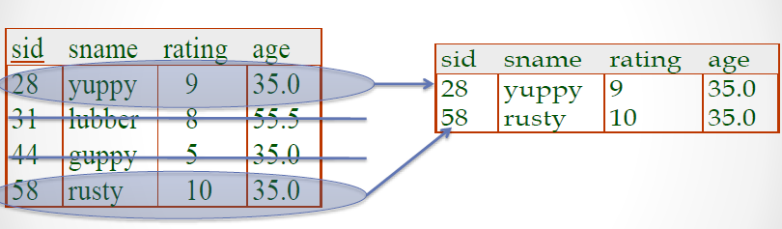
Unary Relational Operations: SELECT
Selects rows that satisfy selection condition

Slide 14
Unary Relational Operations: PROJECT
The SELECT operation - chooses some of the rows from the table while discarding other rows.
The PROJECT operation - selects certain columns from the table and discards the other columns.
  If we are interested in only certain attributes of a relation, we use the PROJECT operation to project the relation over these attributes only
The result of the PROJECT operation can be visualized as a vertical partition of the relation into two relations
    The list of specified columns (attributes) is kept in each tuple
    The other attributes in each tuple are discarded
PROJECT Operation - denoted by π (pi)

Slide 15
Unary Relational Operations: PROJECT
Example: To list each employee’s first and last name and salary, the following is used
  π_{LNAME, FNAME,SALARY}(EMPLOYEE)
The general form of the project operation is:
π_{<attribute list>}(R)
  π (pi) is the symbol used to represent the project operation
  <attribute list> is the desired list of attributes from relation R
The project operation removes any duplicate tuples
  This is because the result of the project operation must be a set of tuples
  If duplicates are not eliminated, the result would be a multiset or bag of tuples rather than a set
  Mathematical sets do not allow duplicate elements

Slide 16
Unary Relational Operations: PROJECT
PROJECT Operation Properties
  The number of tuples in the result of projection π_{<list>}(R) is always less or equal to the number of tuples in R
  If the list of attributes includes a key of R, then the number of tuples in the result of PROJECT is equal to the number of tuples in R
    The result of the PROJECT operation has only the attributes specified in <attribute list> in the same order as they appear in the list. Hence, its degree is equal to the number of attributes in <attribute list>
  PROJECT is not commutative
    π _{<list1>} (π _{<list2>} (R) ) = π _{<list1>} (R) as long as <list2> contains the attributes in <list1>

Slide 17
Unary Relational Operations: PROJECT
In SQL, the PROJECT attribute list is specified in the SELECT clause of a query
For example, the following operation:
π_{Sex, Salary}(EMPLOYEE)
would correspond to the following SQL query:
SELECT DISTINCT Sex, Salary
FROM EMPLOYEE
Note : if we remove the keyword DISTINCT from this SQL query, then duplicates will not be eliminated

Slide 18
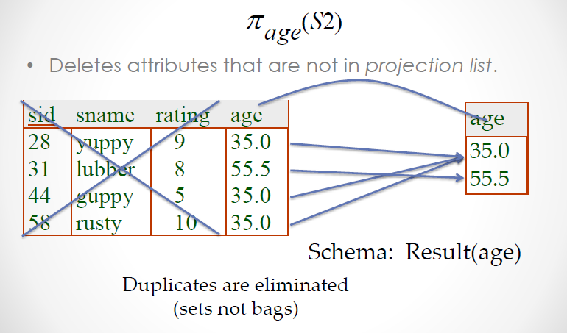
Unary Relational Operations: PROJECT

Slide 19
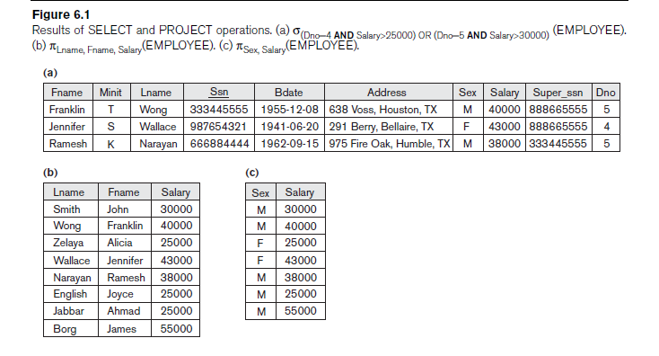
Unary Relational Operations: SELECT

Slide 20
Relational Algebra Expressions
We may want to apply several relational algebra operations one after the other
  Either we can write the operations as a single relational algebra expression by nesting the operations, or
  We can apply one operation at a time and create intermediate result relations
In the latter case, we must give names to the relations that hold the intermediate results

Slide 21
Single expression versus sequence of relational operations (Example)
To retrieve the first name, last name, and salary of all employees who work in department number 5, we must apply a select and a project operation
We can write a single relational algebra expression as follows:
  π_{FNAME, LNAME, SALARY}(σ _{DNO=5}(EMPLOYEE))
(OR) We can explicitly show the sequence of operations, giving a name to each intermediate relation:
  DEP5_EMPS ← σ _{DNO=5}(EMPLOYEE)
  RESULT ← π _{FNAME, LNAME, SALARY} (DEP5_EMPS)

Slide 22
Unary Relational Operations: RENAME
The RENAME operator is denoted by ρ (rho)
In some cases, we may want to rename the attributes of a relation or the relation name or both
  Useful when a query requires multiple operations
  Necessary in some cases (see JOIN operation later)
The general RENAME operation ρ can be expressed by any of the following forms
    ρ_{S (B1, B2, …, Bn )}(R) changes both
    the relation name to S, and
    the column (attribute) names to B1, B1, …..,Bn
  ρ_{S}(R) changes
    the relation name only to S
  ρ_{(B1, B2, …, Bn )}(R) changes
    the column (attribute) names only to B1, B1, …..Bn

Slide 23
Unary Relational Operations: RENAME
For convenience, we also use a shorthand for renaming attributes in an intermediate relation
  If we write:
    RESULT ← π _{FNAME, LNAME, SALARY} (DEP5_EMPS)
    RESULT will have the same attribute names as DEP5_EMPS (same attributes as EMPLOYEE)
  If we write:
    RESULT (F, M, L, S, B, A, SX, SAL, SU, DNO)← π _{FNAME, LNAME, SALARY} (DEP5_EMPS)
    The 10 attributes of DEP5_EMPS are renamed to F, M, L, S, B, A, SX, SAL, SU, DNO, respectively

Slide 24
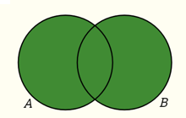
Relational Algebra Operations from
Set Theory : UNION
UNION Operation
  Binary operation, denoted by ∪
  The result of R ∪ S, is a relation that includes all tuples that are either in R or in S or in both R and S
  Duplicate tuples are eliminated
  The two operand relations R and S must be “type compatible” (or UNION compatible)
    R and S must have same number of attributes (arity)
    Each pair of corresponding attributes must be type compatible (have same or compatible domains)
Two relations R(A1, A2, ..., An) and S(B1, B2, ..., Bn) are said to be union compatible (or type compatible) if they have the same degree n and if dom(Ai) = dom(Bi) for 1 ≤i ≤ n

Slide 25
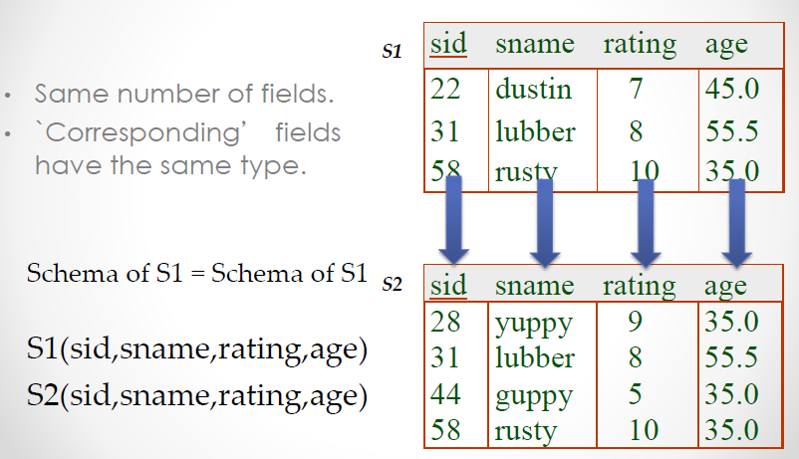
Union Compatible

Slide 26
Relational Algebra Operations from
Set Theory : UNION
Three operations UNION, INTERSECTION, and SET DIFFERENCE on two union-compatible relations R and S are defined as follows:
  UNION: The result of this operation, denoted by R ∪ S, is a relation that includes all tuples that are either in R or in S or in both R and S. Duplicate tuples are eliminated
  INTERSECTION: The result of this operation, denoted by R ∩ S, is a relation that includes all tuples that are in both R and S
  SET DIFFERENCE (or MINUS): The result of this operation, denoted by R – S, is a relation that includes all tuples that are in R but not in S

Slide 27
Relational Algebra Operations from
Set Theory : UNION
Example
  To retrieve the social security numbers of all employees who either work in department 5 (RESULT1 below) or directly supervise an employee who works in department 5 (RESULT2 below)
  We can use the UNION operation as follows:
DEP5_EMPS ← σ_{DNO=5} (EMPLOYEE)
RESULT1 ← π _{SSN}(DEP5_EMPS)
RESULT2(SSN) ← π_{SUPERSSN}(DEP5_EMPS)
RESULT ← RESULT1 ∪ RESULT2
  The union operation produces the tuples that are in either RESULT1 or RESULT2 or both

Slide 28
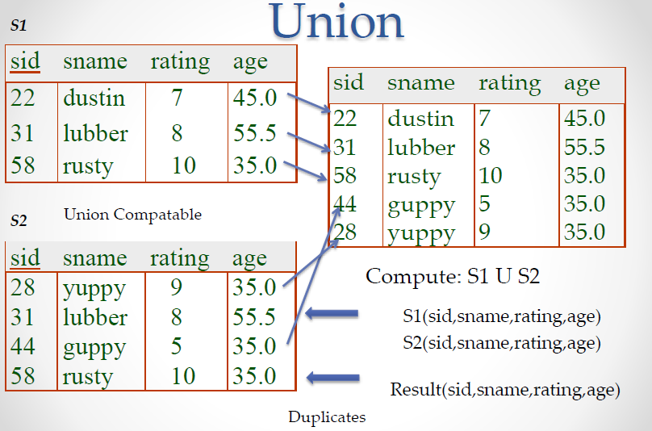
Relational Algebra Operations from
Set Theory : UNION

Slide 29
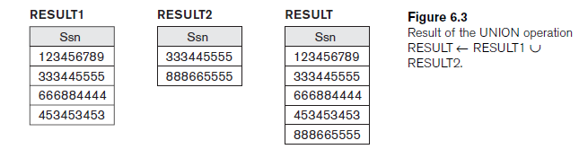
Relational Algebra Operations from
Set Theory : UNION

Slide 30
Relational Algebra Operations from
Set Theory
Type Compatibility of operands is required for the binary set operation UNION ∪, (also for INTERSECTION ∩, and SET DIFFERENCE – )
R1(A1, A2, ..., An) and R2(B1, B2, ..., Bn) are type compatible if:
  they have the same number of attributes, and
  the domains of corresponding attributes are type compatible (i.e. dom(Ai)=dom(Bi) for i=1, 2, ..., n)
The resulting relation for R1∪R2 (also for R1∩R2, or R1–R2) has the same attribute names as the first operand relation R1 (by convention)

Slide 31
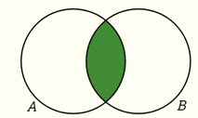
Relational Algebra Operations from Set Theory: INTERSECTION
INTERSECTION is denoted by ∩
The result of the operation R ∩ S, is a relation that includes all tuples that are in both R and S
  The attribute names in the result will be the same as the attribute names in R
The two operand relations R and S must be “type compatible”

Slide 32
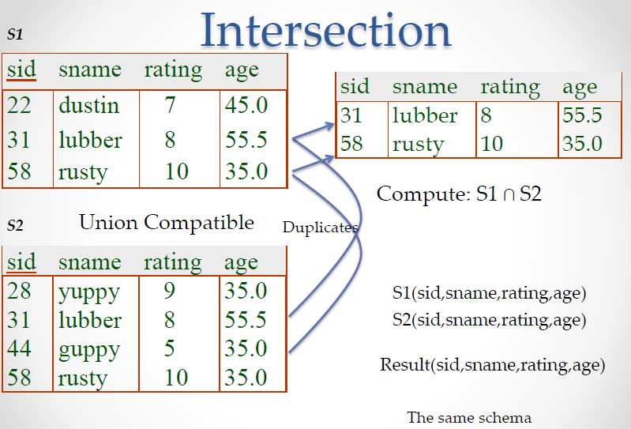
Relational Algebra Operations from Set Theory: INTERSECTION

Slide 33
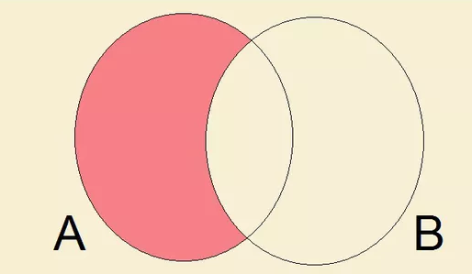
Relational Algebra Operations from Set Theory: SET DIFFERENCE
SET DIFFERENCE (also called MINUS or EXCEPT) is denoted by –
The result of R – S, is a relation that includes all tuples that are in R but not in S
  The attribute names in the result will be the same as the attribute names in R
The two operand relations R and S must be “type compatible”

Slide 34
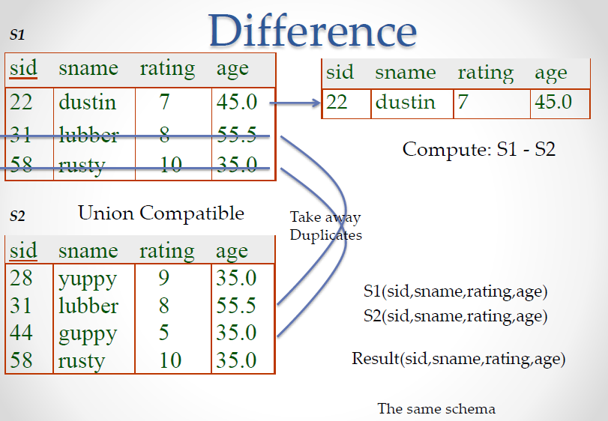
Relational Algebra Operations from Set Theory: SET DIFFERENCE

Slide 35
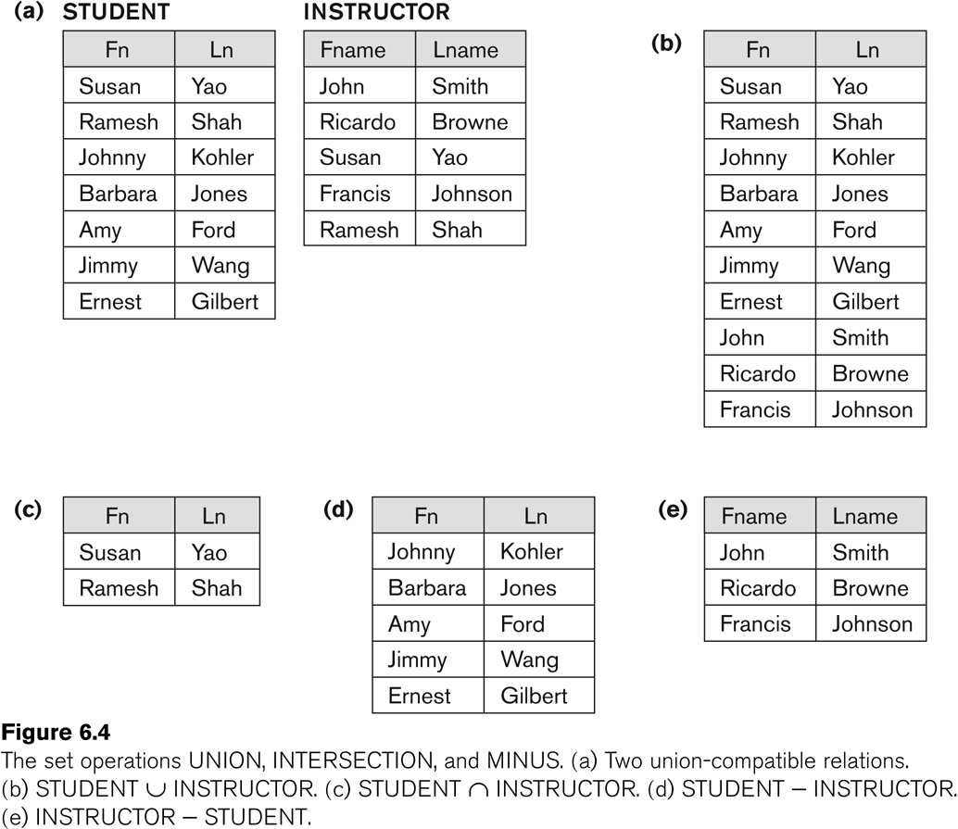
Example to illustrate the result of UNION, INTERSECT, and DIFFERENCE

Slide 36
Some Properties of UNION, INTERSECT, and DIFFERENCE
Notice that both union and intersection are commutative operations; that is
  R ∪ S = S ∪ R, and R ∩ S = S ∩ R
Both union and intersection can be treated as n-ary operations applicable to any number of relations as both are associative operations; that is
  R ∪ (S ∪ T) = (R ∪ S) ∪ T
  (R ∩ S) ∩ T = R ∩ (S ∩ T)
The minus operation is not commutative; that is, in general
  R – S ≠ S – R

Slide 37
Relational Algebra Operations from Set Theory: CARTESIAN PRODUCT
CARTESIAN (or CROSS) PRODUCT Operation
  This operation is used to combine tuples from two relations in a combinatorial fashion
  Denoted by R(A1, A2, . . ., An) x S(B1, B2, . . ., Bm)
  Result is a relation Q with degree n + m attributes
    Q(A1, A2, . . ., An, B1, B2, . . ., Bm), in that order
  The resulting relation state has one tuple for each combination of tuples—one from R and one from S.
  Hence, if R has n_{R} tuples (denoted as |R| = n_{R} ), and S has n_{S} tuples, then R x S will have n_{R} * n_{S} tuples
  The two operands do NOT have to be "type compatible”

Slide 38
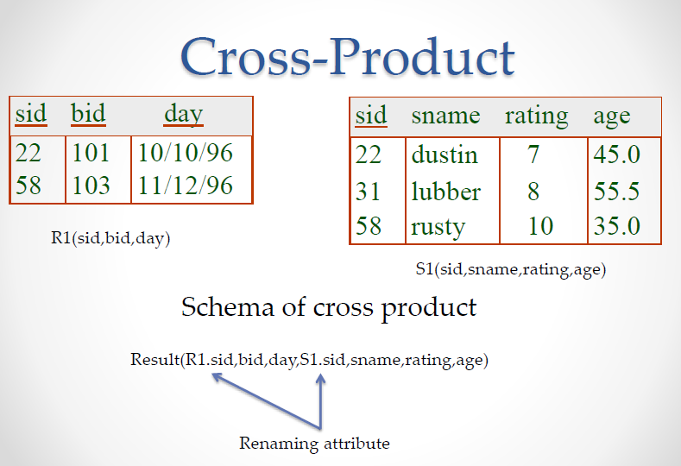
CARTESIAN PRODUCT

Slide 39
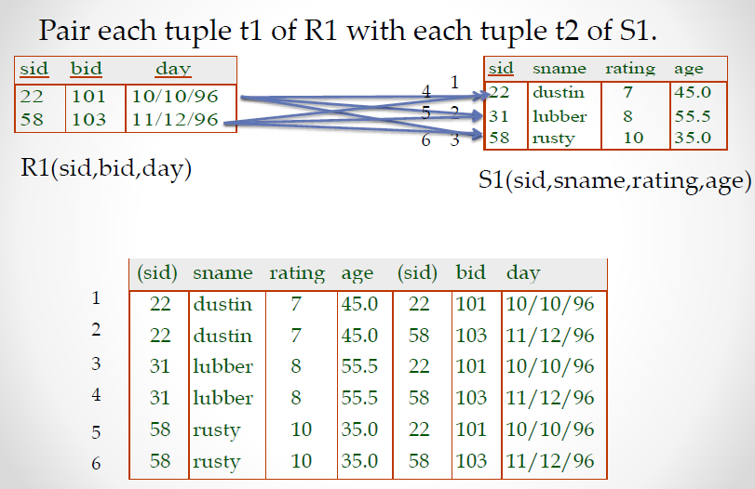
CARTESIAN PRODUCT

Slide 40
Relational Algebra Operations from Set Theory: CARTESIAN PRODUCT
Generally, CROSS PRODUCT is not a meaningful operation
  Can become meaningful when followed by other operations
Example (not meaningful)
  FEMALE_EMPS ← σ _{SEX=’F’}(EMPLOYEE)
  EMPNAMES ← π _{FNAME, LNAME, SSN} (FEMALE_EMPS)
  EMP_DEPENDENTS ← EMPNAMES x DEPENDENT
EMP_DEPENDENTS will contain every combination of EMPNAMES and DEPENDENT
  whether or not they are actually related

Slide 41
Relational Algebra Operations from Set Theory: CARTESIAN PRODUCT
To keep only combinations where the DEPENDENT is related to the EMPLOYEE, add a SELECT operation as follows
Example (meaningful)
  FEMALE_EMPS ← σ _{SEX=’F’}(EMPLOYEE)
  EMPNAMES ← π _{FNAME, LNAME, SSN} (FEMALE_EMPS)
  EMP_DEPENDENTS ← EMPNAMES x DEPENDENT
  ACTUAL_DEPS ← σ _{SSN=ESSN}(EMP_DEPENDENTS)
  RESULT ← π _{FNAME, LNAME, DEPENDENT_NAME} (ACTUAL_DEPS)
RESULT will now contain the name of female employees and their dependents

Slide 42
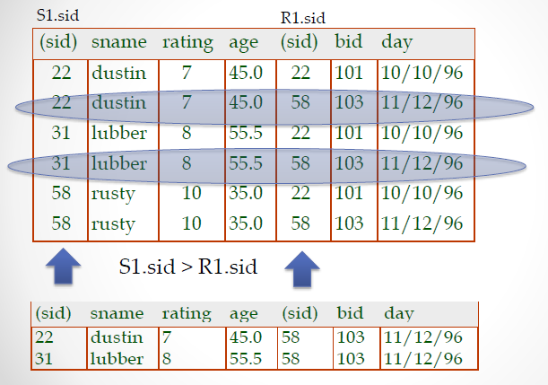
CARTESIAN PRODUCT - SELECTION

Slide 43
Binary Relational Operations: JOIN
JOIN Operation (denoted by )
  The sequence of CARTESIAN PRODECT followed by SELECT is used quite commonly to identify and select related tuples from two relations
  A special operation, called JOIN combines this sequence into a single operation
  This operation is very important for any relational database with more than a single relation, because it allows us combine related tuples from various relations
  The general form of a join operation on two relations R(A1, A2, . . ., An) and S(B1, B2, . . ., Bm) is:
  R _{<join condition>}S
  where R and S can be any relations that result from general relational algebra expressions

Slide 44
Binary Relational Operations: JOIN
Example: Suppose that we want to retrieve the name of the manager of each department
  To get the manager’s name, we need to combine each DEPARTMENT tuple with the EMPLOYEE tuple whose SSN value matches the MGRSSN value in the department tuple.
  We do this by using the join operation
  DEPT_MGR ← DEPARTMENT _{MGRSSN=SSN} EMPLOYEE
MGRSSN=SSN is the join condition
  Combines each department record with the employee who manages the department
  The join condition can also be specified as DEPARTMENT.MGRSSN= EMPLOYEE.SSN

Slide 45
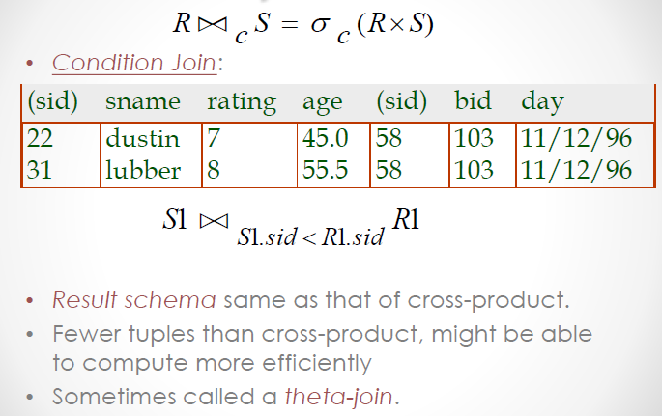
Joins

Slide 46
Some properties of JOIN
Consider the following JOIN operation:
  R(A1, A2, . . ., An) S(B1, B2, . . ., Bm)
    R.Ai=S.Bj
  Result is a relation Q with degree n + m attributes:
    Q(A1, A2, . . ., An, B1, B2, . . ., Bm), in that order.
  The resulting relation state has one tuple for each combination of tuples—r from R and s from S, but only if they satisfy the join condition r[Ai]=s[Bj]
  Hence, if R has n_{R} tuples, and S has n_{S} tuples, then the join result will generally have less than n_{R} * n_{S} tuples
  Only related tuples (based on the join condition) will appear in the result

Slide 47
Some properties of JOIN
The general case of JOIN operation is called a Theta-join: R S
    theta
The join condition is called theta
Theta can be any general boolean expression on the attributes of R and S;
  For example
  R.Ai<S.Bj AND (R.Ak=S.Bl OR R.Ap<S.Bq)
Most join conditions involve one or more equality conditions “AND”ed together;
  For example:
  R.Ai=S.Bj AND R.Ak=S.Bl AND R.Ap=S.Bq

Slide 48
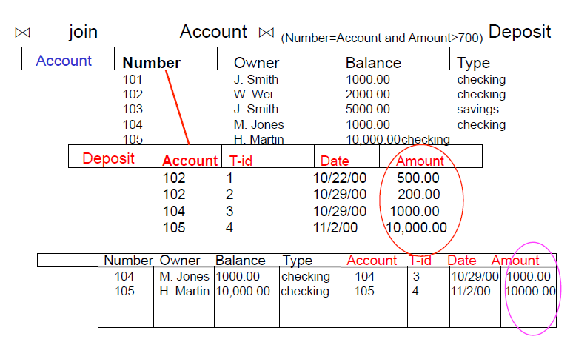
Join : Example

Slide 49
Binary Relational Operations: EQUIJOIN
The most common use of join involves join conditions with equality comparisons only
Such a join, where the only comparison operator used is =, is called an EQUIJOIN
  In the result of an EQUIJOIN we always have one or more pairs of attributes (whose names need not be identical) that have identical values in every tuple
Special case of condition join where the condition c contains only equalities
Result schema similar to cross-product
  but only one copy of fields for which equality is specified

Slide 50
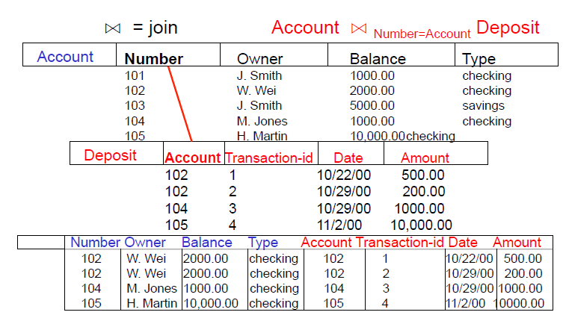
Binary Relational Operations: EQUIJOIN

Slide 51
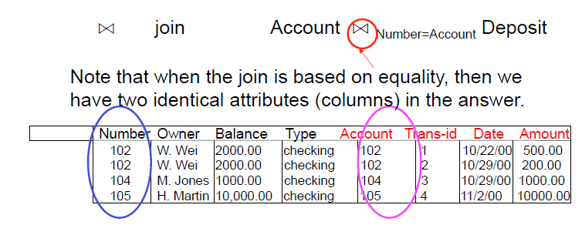
Binary Relational Operations: EQUIJOIN

Slide 52
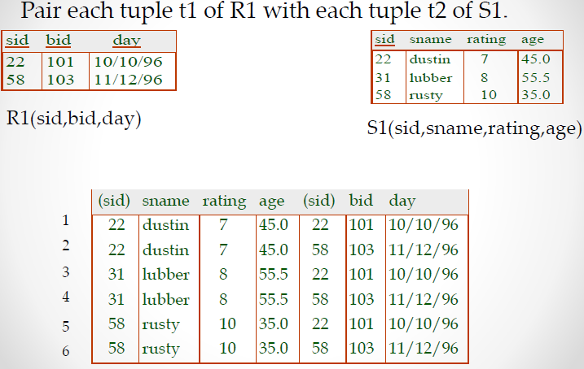
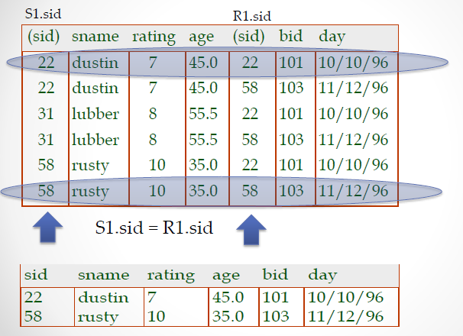
EQUIJOIN

Slide 53
Binary Relational Operations:
NATURAL JOIN Operation
Another variation of JOIN called NATURAL JOIN
  denoted by *
  was created to get rid of the second (superfluous) attribute in an EQUIJOIN condition
    because one of each pair of attributes with identical values is superfluous
  The standard definition of natural join requires that the two join attributes, or each pair of corresponding join attributes, have the same name in both relations
  If this is not the case, a renaming operation is applied first

Slide 54
Binary Relational Operations :
NATURAL JOIN
Example: To apply a natural join on the DNUMBER attributes of DEPARTMENT and DEPT_LOCATIONS, it is sufficient to write:
  DEPT_LOCS ← DEPARTMENT * DEPT_LOCATIONS
Only attribute with the same name is DNUMBER
An implicit join condition is created based on this attribute:
  DEPARTMENT.DNUMBER=DEPT_LOCATIONS.DNUMBER
Another example: Q ← R(A,B,C,D) * S(C,D,E)
  The implicit join condition includes each pair of attributes with the same name, “AND”ed together:
    R.C=S.C AND R.D.S.D
  Result keeps only one attribute of each such pair:
    Q(A,B,C,D,E)

Slide 55
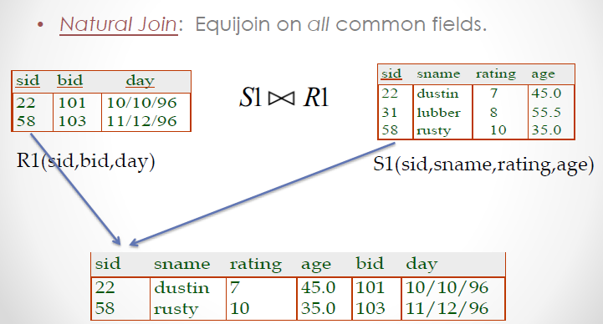
Natural Join

Slide 56

Question
How could you express the natural join operation if you didn’t have a natural join operator in relational algebra? Consider you have two relations R(A,B,C) and S(B,C,D)

Slide 57
Complete Set of Relational Operations
The set of operations including SELECT σ, PROJECT π , UNION ∪, DIFFERENCE − , RENAME ρ, and CARTESIAN PRODUCT X is called a complete set
  Any other relational algebra expression can be expressed by a combination of these five operations
For example
  R ∩ S = (R ∪ S ) – ((R − S) ∪ (S − R))
  R _{<join condition>}S = σ _{<join condition>} (R X S)

Slide 58
Challenging Question
How could you express the intersection operation if you didn’t have an Intersection operator in relational algebra?
[Hint: Can you express Intersection using only the Difference
  operator?]
  A ∩ B = ???

Slide 59
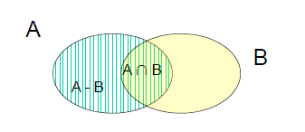
Challenging Question
How could you express the intersection operation if you didn’t have an Intersection operator in relational algebra?
[Hint: Can you express Intersection using only the Difference
  operator?]
  A ∩ B = A – (A - B)

Slide 60
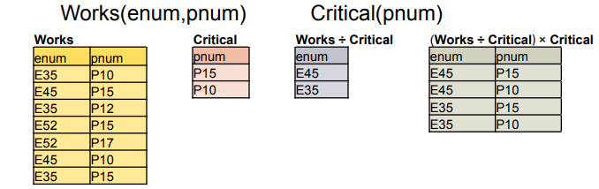
Binary Relational Operations: DIVISION
Binary operator - R ÷ S
Attributes of S must be a subset of the attributes of R
attr(R ÷ S) = attr(R) – attr(S)
t tuple in (R ÷ S) iff (t × S) is a subset of R
Used to answer questions involving all
  e.g., Which employees work on all the critical projects?
  “Inverse” of cross product

Slide 61
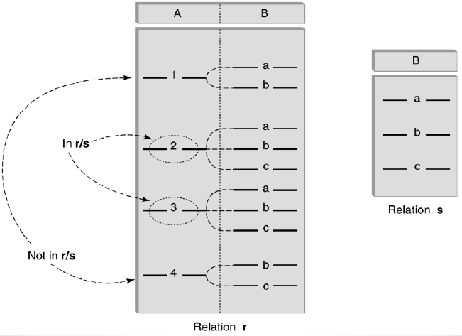
Binary Relational Operations: DIVISION

Slide 62
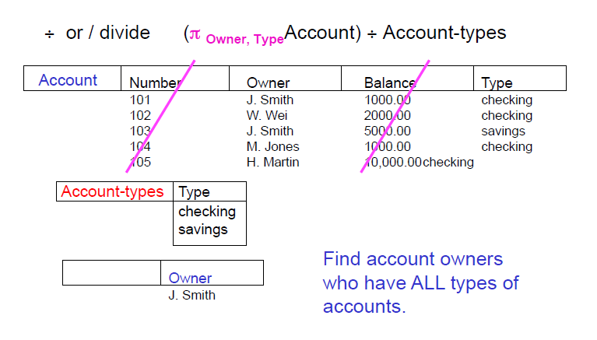
Binary Relational Operations: DIVISION

Slide 63
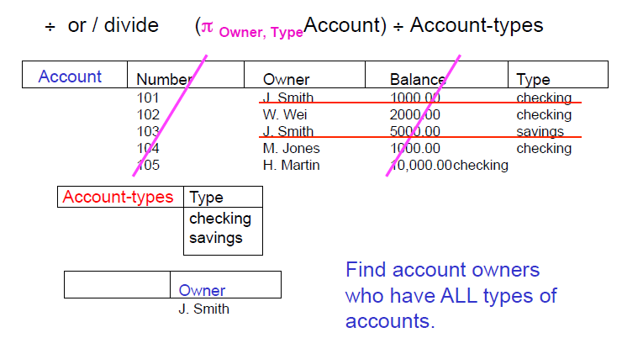
Binary Relational Operations: DIVISION

Slide 64
Divide Operator
For R ÷ S where R (r1, r2, r3, r4) and S(s1, s2)
Since S has two attributes, there must be two attributes in R (say r3 and r4) that are defined on the same domains, respectively, as s1 and s2.
  We could say that (r3, r4) is union-compatible with (s1, s2)
The query answer has the remaining attributes (r1, r2) And the answer has a tuple (r1, r2) in the answer if the (r1, r2) value appears with every S tuple in R

Slide 65


Binary Relational Operations: DIVISION
The DIVISION operation - useful for a special kind of query that sometimes occurs in database applications
Example - Retrieve the names of employees who work on all the projects that ‘John Smith’ works on

Slide 66
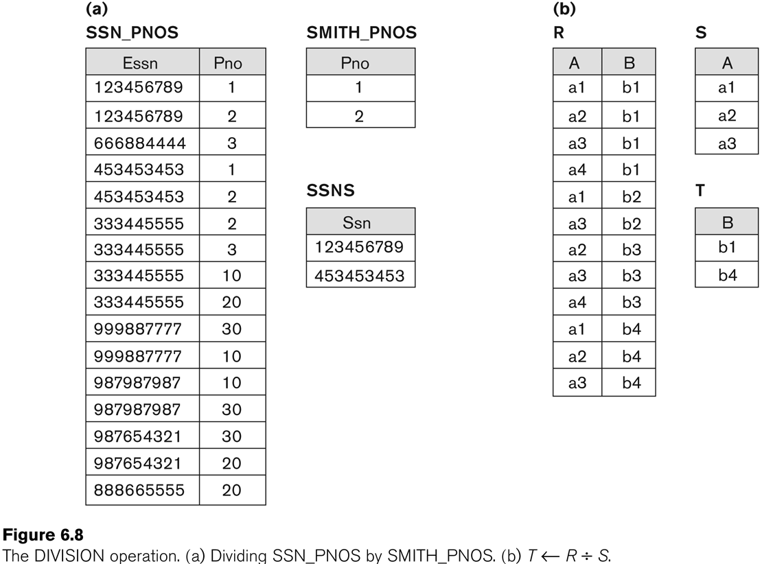
Example of DIVISION

Slide 67
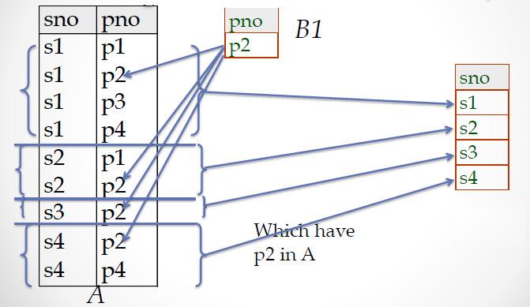
Binary Relational Operations: DIVISION
A B1

Slide 68
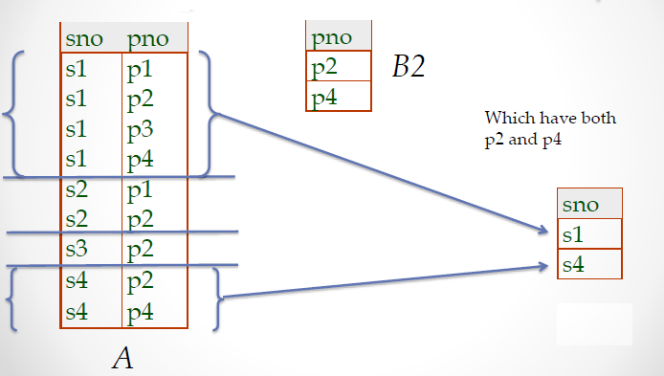
Binary Relational Operations: DIVISION
A B2

Slide 69
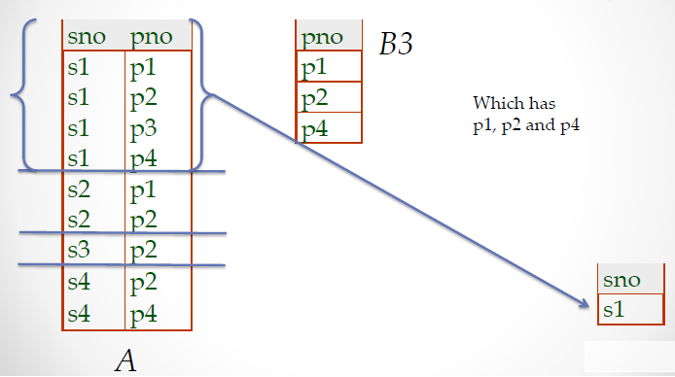
Binary Relational Operations: DIVISION
A B3

Slide 70
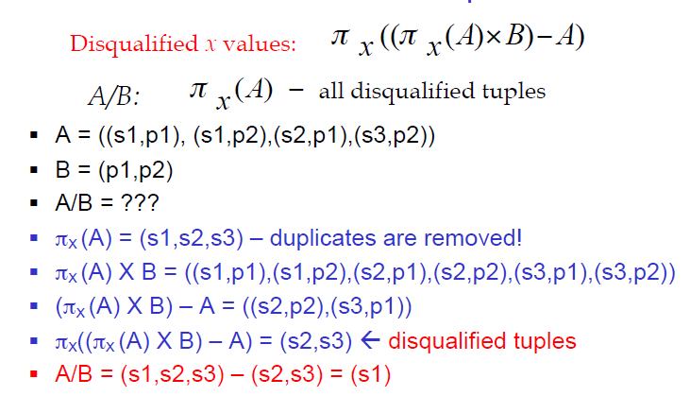
Expressing A/B Using Basic Operators
Division is not an essential operator, but it provides a useful shorthand
Example

Slide 71
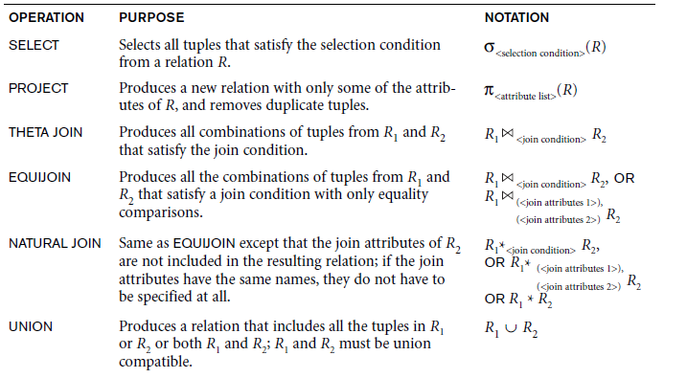
Recap of Relational Algebra Operations

Slide 72
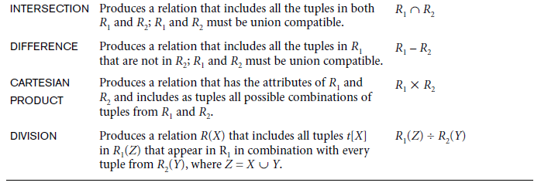
Recap of Relational Algebra Operations

Slide 73
Building Complex Expressions
Combine operators with parentheses and precedence rules
Three notations, just as in arithmetic
  1. Sequences of assignment statements
  2. Expressions with several operators
  3. Expression trees

Slide 74
Sequences of Assignments
Create temporary relation names
  Renaming can be implied by giving relations a list of attributes
Example
  R3 := R1 ⋈C R2 can be written
    R4 := R1 Χ R2
    R3 := σC (R4)
Example: Write r ÷ s as
temp1 := Π_{R-S} (r)
temp2 := Π_{R-S} ((temp1 x s) – Π_{R-S,S} (r))
result := temp1 – temp2

Slide 75
Expressions in a Single Assignment
Example
  The theta-join R3 := R1 ⋈_{C} R2 can be written
  R3 := σ_{C} (R1 Χ R2)
Precedence of relational operators
  1. [σ, π, ρ] (highest)
  2. [Χ, ⋈]
  3. ∩
  4. [∪, —]

Slide 76
Expression Trees
Leaves are operands - either variables standing for relations or particular, constant relations
Interior nodes are operators, applied to their child or children
Example: Tree for a Query
Using the relations
Bookstore(name, addr) and
Sells(store, book, price)
Find the names of all the stores that are either on Maple St. or sell
HTML Primer for less than $3

Slide 77
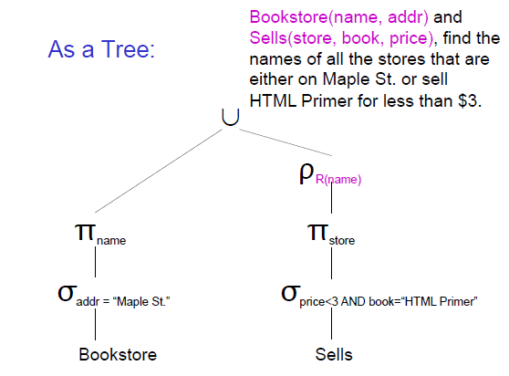

Slide 78
Additional Relational Operations: Generalized Projection
Extends the projection operation by allowing functions of attributes to be included in the projection list
General form : π_{F1, F2, ..., Fn} (R)
  where F1, F2, ..., Fn are functions over the attributes in relation R and may involve arithmetic operations and constant values
Example
  EMPLOYEE (Ssn, Salary, Deduction, Years_service)
A report may be required to show
  Net Salary = Salary – Deduction,
  Bonus = 2000 * Years_service, and
  Tax = 0.25 * Salary
Generalized projection combined with renaming
  REPORT ← ρ(Ssn, Net_salary, Bonus, Tax)(πSsn, Salary – Deduction, 2000 * Years_service 0.25 * Salary(EMPLOYEE))

Slide 79
Additional Relational Operations : Aggregate Functions and Grouping
A type of request that cannot be expressed in the basic relational algebra is to specify mathematical aggregate functions on collections of values from the database
Examples
  Retrieving the average or total salary of all employees or the total number of employee tuples
These functions are used in simple statistical queries that summarize information from the database tuples
Common functions applied to collections of numeric values include
  SUM - sum of values
  AVERAGE - average value
  MAXIMUM – maximum value
  MINIMUM – minimum value
The COUNT function is used for counting tuples or values
  Count – number of values

Slide 80
Aggregate Function Operation
Use of the Aggregate Functional operation ℱ
  ℱ_{MAX Salary} (EMPLOYEE) - retrieves the maximum salary value from the EMPLOYEE relation
  ℱ_{MIN Salary} (EMPLOYEE) - retrieves the minimum Salary value from the EMPLOYEE relation
  ℱ_{SUM Salary} (EMPLOYEE) - retrieves the sum of the Salary from the EMPLOYEE relation
  ℱ_{COUNT SSN, AVERAGE Salary} (EMPLOYEE) - computes the count (number) of employees and their average salary
    Note: count just counts the number of rows, without removing duplicates

Slide 81
Using Grouping with Aggregation
Grouping can be combined with Aggregate Functions
Example: For each department, retrieve the DNO, COUNT SSN, and AVERAGE SALARY
A variation of aggregate operation ℱ allows this:
  Grouping attribute placed to left of symbol
  Aggregate functions to right of symbol
  _{DNO} ℱ_{COUNT SSN, AVERAGE Salary} (EMPLOYEE)
  Above operation groups employees by DNO (department number) and computes the count of employees and average salary per department

Slide 82
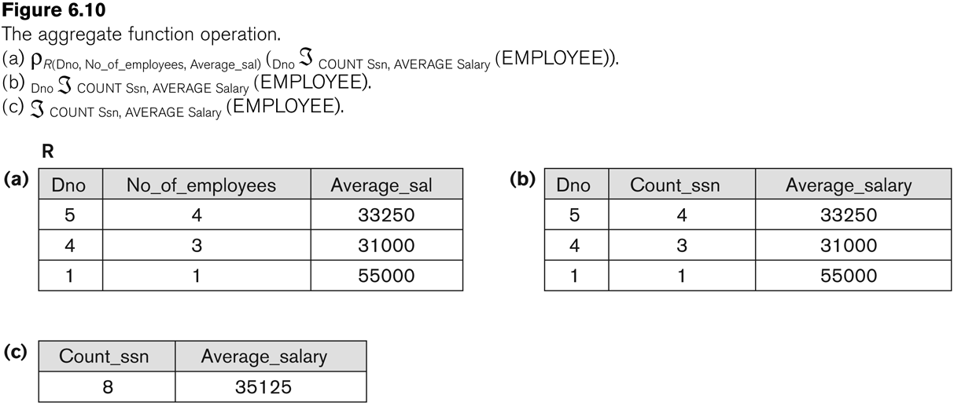
Examples of applying aggregate functions and grouping

Slide 83
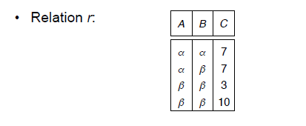

Aggregate Operation – Example
ℱ_{SUM(C)} (r)

Slide 84
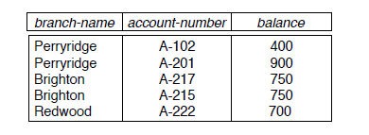

Examples of applying aggregate functions and grouping
Consider the following ACCOUNT relation
ρ _{branch-name} ℱ _{sum(balance)} (ACCOUNT)

Slide 85
Additional Relational Operations
Recursive Closure Operations
  Another type of operation that, in general, cannot be specified in the basic original relational algebra is recursive closure
  This operation is applied to a recursive relationship
  An example of a recursive operation is to retrieve all SUPERVISEES of an EMPLOYEE e at all levels — that is,
    all EMPLOYEE e’ directly supervised by e
    all employees e’’ directly supervised by each employee e’
    all employees e’’’ directly supervised by each employee e’’
    …

Slide 86

Additional Relational Operations
It is relatively straightforward in the relational algebra to specify all employees supervised by e at a specific level by joining the table with itself one or more times
However, it is difficult to specify all supervisees at all levels
For example
  to specify the Ssns of all employees e directly supervised—at level one—by the employee e whose name is ‘James Borg’,

Slide 87
Additional Relational Operations
To retrieve all employees supervised by Borg at level 2—that is, all employees e supervised by some employee e who is directly supervised by Borg—we can apply another JOIN to the result of the first query, as follows:
To get both sets of employees supervised at levels 1 and 2 by ‘James Borg’, we can apply the UNION operation to the two results, as follows:

Slide 88
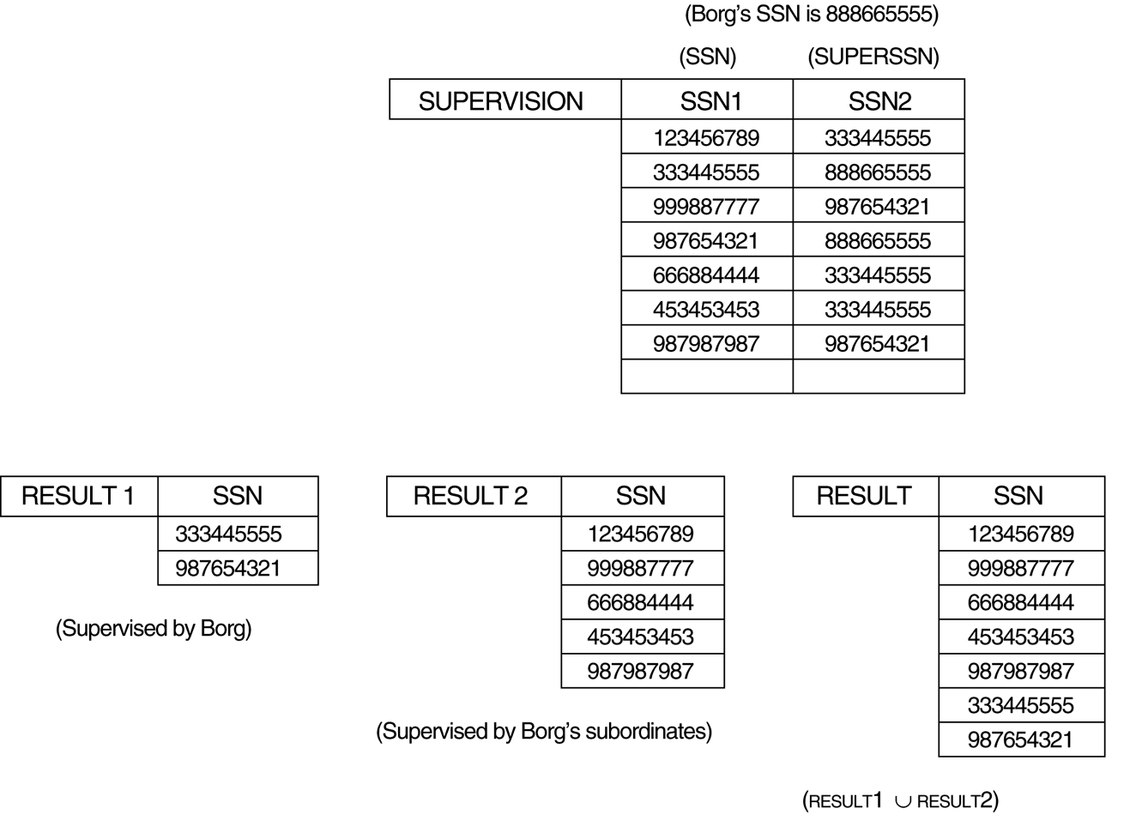
Additional Relational Operations

Slide 89
Outer Join Operations
JOIN operations – include tuples that satisfy the join condition
  For example, for a NATURAL JOIN operation R * S, only tuples from R that have matching tuples in S-and vice versa-appear in the result.
  Hence, tuples without a matching (or related) tuple are eliminated from the JOIN result -
  Tuples with NULL values in the join attributes are also eliminated
  This type of join, where tuples with no match are eliminated, is known as an inner join
Inner Joins
  Theta Join
  Equi Join
  Natural Join
Outer Joins - An extension of the join operation that avoids loss of information

Slide 90

Outer Join Operations
Three Outer Joins
  Left outer Join -
  Right outer Join -
  Full Outer Join -
necessary to specify certain types of queries
For example
  Display the list of all employee names as well as the name of the departments they manage (if they happen to manage a department), if they do not manage one, we can indicate it with a NULL value
Apply an operation LEFT OUTER JOIN to retrieve the result

Slide 91
Outer Join Operations
Left outer join
  The left outer join operation keeps every tuple in the first or left relation R in R S; if no matching tuple is found in S, then the attributes of S in the join result are filled or “padded” with null values
Right outer join
  A similar operation, right outer join, keeps every tuple in the second or right relation S in the result of R S
Full outer join
  R S, keeps all tuples in both the left and the right relations when no matching tuples are found, padding them with null values as needed

Slide 92
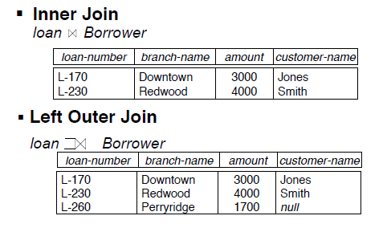
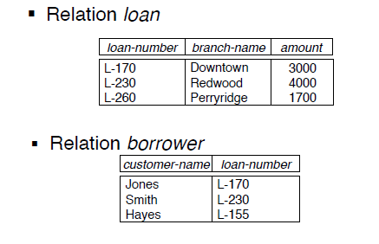
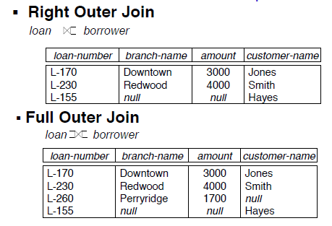
Outer Join - Example

Slide 93
OUTER UNION Operations
  The outer union operation was developed to take the union of tuples from two relations if the relations are not type compatible
  This operation will take the union of tuples in two relations R(X, Y) and S(X, Z) that are partially compatible, meaning that only some of their attributes, say X, are type compatible
  The attributes that are type compatible are represented only once in the result, and those attributes that are not type compatible from either relation are also kept in the result relation T(X, Y, Z)
Example: An outer union can be applied to two relations whose schemas are STUDENT(Name, SSN, Department, Advisor) and INSTRUCTOR(Name, SSN, Department, Rank)
  Tuples from the two relations are matched based on having the same combination of values of the shared attributes - Name, SSN, Department
  If a student is also an instructor, both Advisor and Rank will have a value; otherwise, one of these two attributes will be null
  The result relation STUDENT_OR_INSTRUCTOR will have the following attributes:
STUDENT_OR_INSTRUCTOR (Name, SSN, Department, Advisor, Rank)

Slide 94
Relational Algebra consists of several groups of operations
Unary Relational Operations
  SELECT (symbol: σ (sigma))
  PROJECT (symbol: π (pi))
  RENAME (symbol: ρ (rho))
Relational Algebra Operations From Set Theory
  UNION (∪), INTERSECTION (∩), DIFFERENCE (–), CARTESIAN PRODUCT ( x )
Binary Relational Operations
  JOIN (several variations of JOIN exist)
  DIVISION
Additional Relational Operations
  OUTER JOINS, OUTER UNION
  AGGREGATE FUNCTIONS (These compute summary of information)
  For example, SUM, COUNT, AVG, MIN, MAX

Slide 95
Summary
The relational model has rigorously defined query languages that are simple and powerful
Relational algebra is more operational; useful as internal representation for query evaluation plans
Several ways of expressing a given query; a query optimizer should choose the most efficient version

